Slide 1
welcome

Slide 2
Presented by
Taiammum Uday (2018-1-60-046)
Shabrina Akter Shara (2018-1-60-168)

Slide 3
PROJECT
FIFA World Cup

Slide 4
Project Description
FIFA WORLD CUP
POSIX THREADS
SEMAPHORES

Slide 5
Using semaphore and thread ,we can solve this problem
we use semaphore to solve various synchronization problems. Semaphores are counters for resources shared between processes/threads.
Otherhand Thread applications offer potential performance gains and practical advantages over non-threaded applications in several ways.

Slide 6
Problem discussion
The tram can't carry more than 4 people and must always carry a full load. We cannot put three Italians and one German in the same tram-car, because the Italians would be in majority and we cannot put three Germans in the same tram-car with one Italian.
So safe combinations are:
2 Germans and 2 Italians
2 Italians and 2 Germans
4 Germans and 0 Italians
4 Italians and 0 Germans

Slide 7
Here some important functions which is use in this code
sem_init : A semaphore is initialised by using sem_init
sem_wait :To wait or lock a semaphore
sem_post :To release or signal a semaphore
Sem_destroy :To destroy a semaphore
pthread_create : Used to create a new thread
pthread_join : Used to wait for the termination of a thread

Slide 8
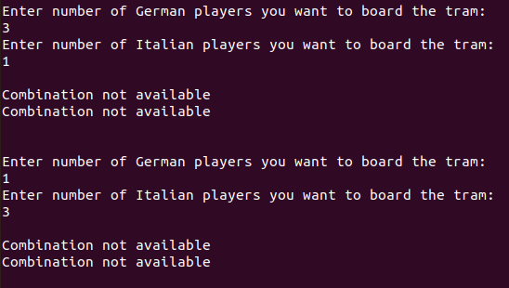
output
If combination violate the majority condition:

Slide 9
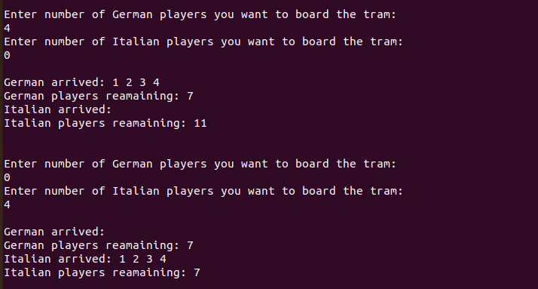
Safe Combinations:

Slide 10
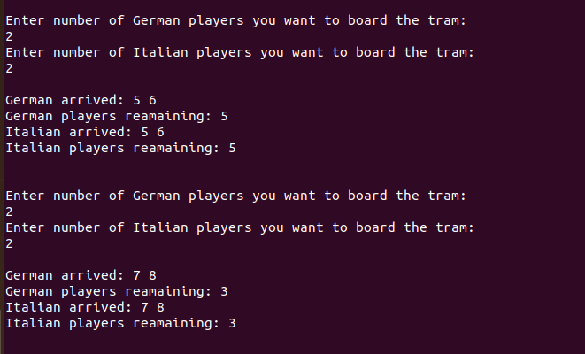

Slide 11
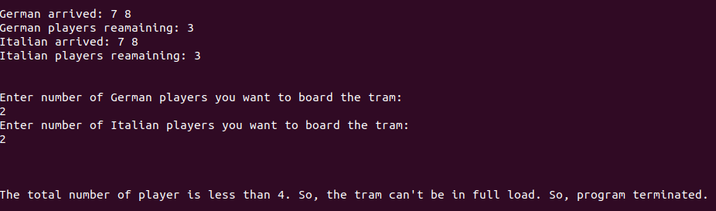
limitation
Using all type safe combinations, always remain 1 player of both teams

Slide 12
Thank you

